Slide 1

Medical Insurance Price Prediction
Karthik Kanaparthi
FO62975

Slide 2
Introduction:
Medical insurance is essential because it shields people from the exorbitant expenses of healthcare. It guarantees that people can receive essential medical care without having to worry about paying excessive costs, which improves health and financial stability.
How medical insurance helps mitigate financial risks associated with healthcare costs?
Financial Coverage for Expensive Treatments: A variety of medical costs, such as pricey procedures, treatments, and hospital stays, are covered by medical insurance. Insurance protects people from the potentially disastrous financial effects of unforeseen medical issues by paying for these costs.
Predictable Expense Management: Medical insurance helps people better plan and manage their finances by converting unpredictable and potentially enormous medical costs into regular, manageable insurance premium payments. This lowers the risk of financial instability due to health-related expenses.

Slide 3
Data Source:
Data set: Kaggle
Size and shape of Data set: 51 KB, 1388(rows) x 7(columns/features)
Time period of data set: 2012 – 2016
Data Contains the following columns:
Age
Sex
BMI (Body Mass Index)
Children
Region
Expenses

Slide 4
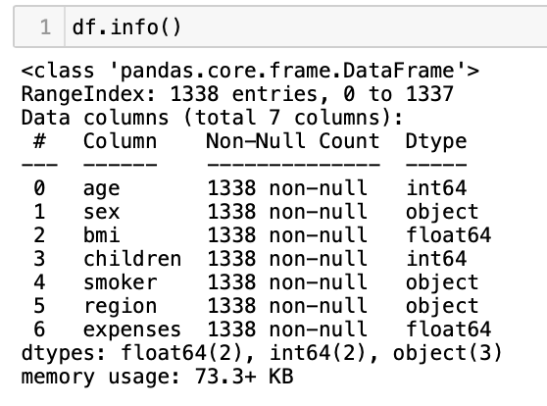
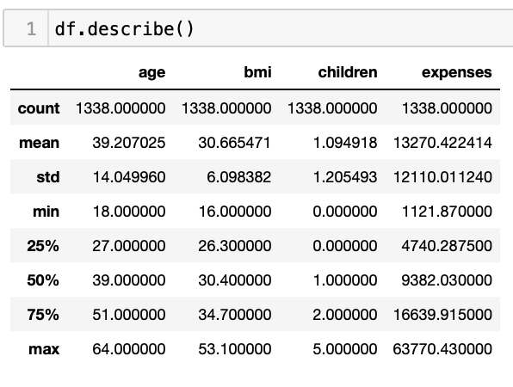
Data Source:

Slide 5
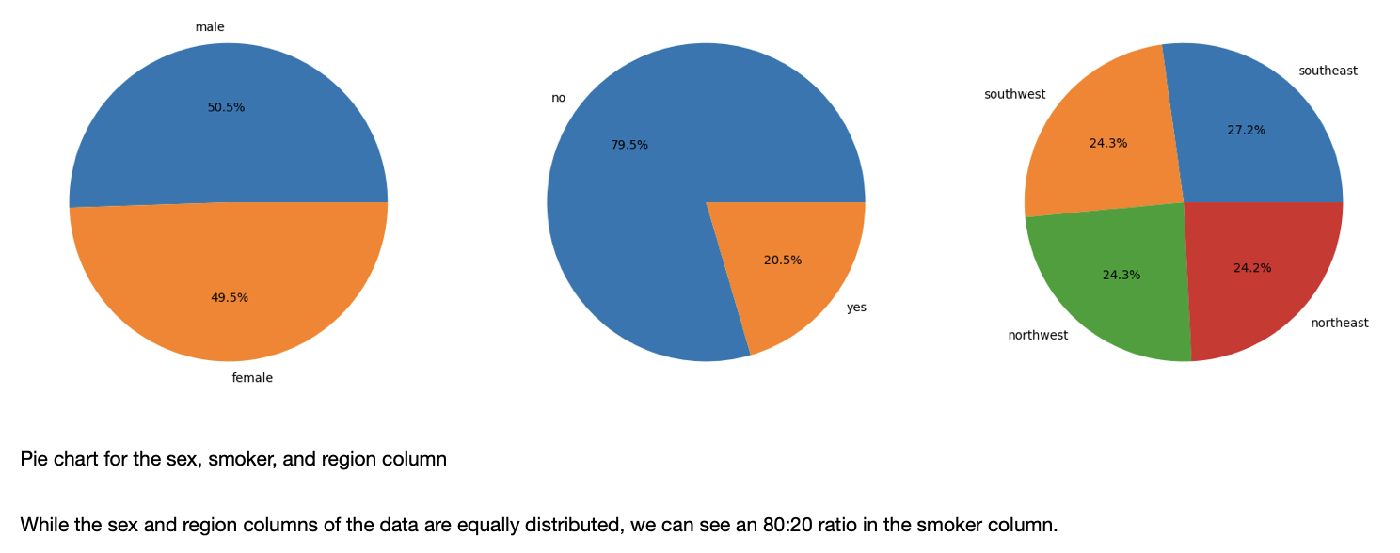
EDA:

Slide 6
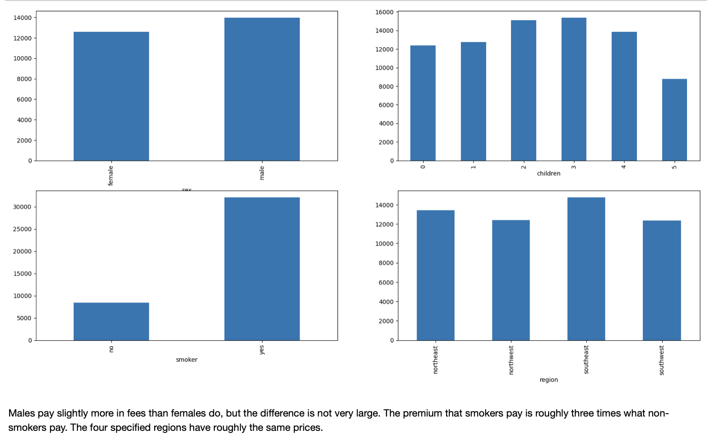
EDA:
Comparison between expenses paid between different groups

Slide 7
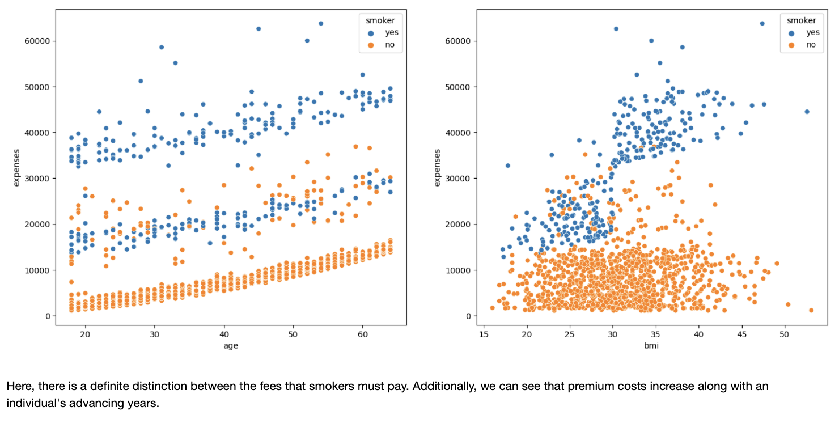
EDA:
Scatter plot of the expenses paid v/s age and BMI respectively

Slide 8
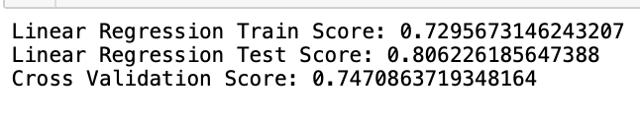
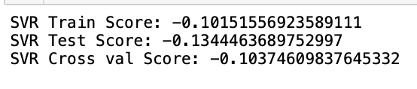
Model Development:
Linear regression:
SVM:

Slide 9
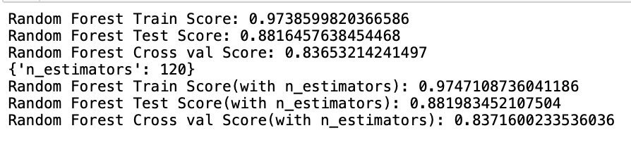
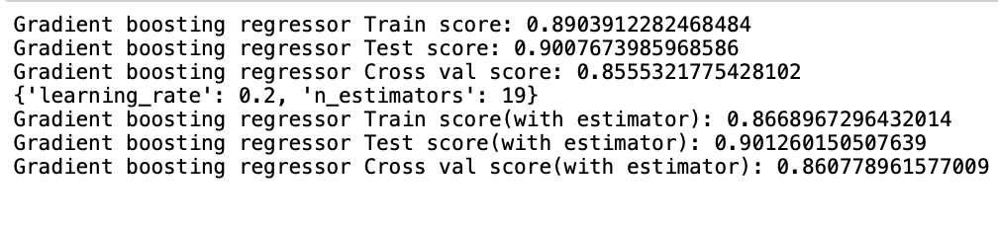
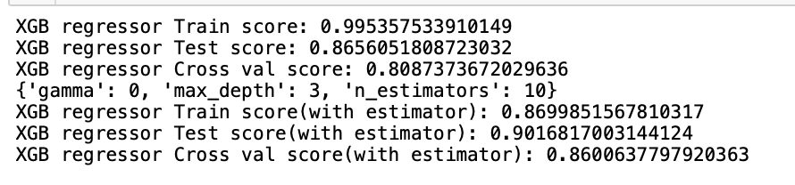
cont.
Random Forest Regressor:
Gradient Boost regressor:
XGB Regressor:

Slide 10
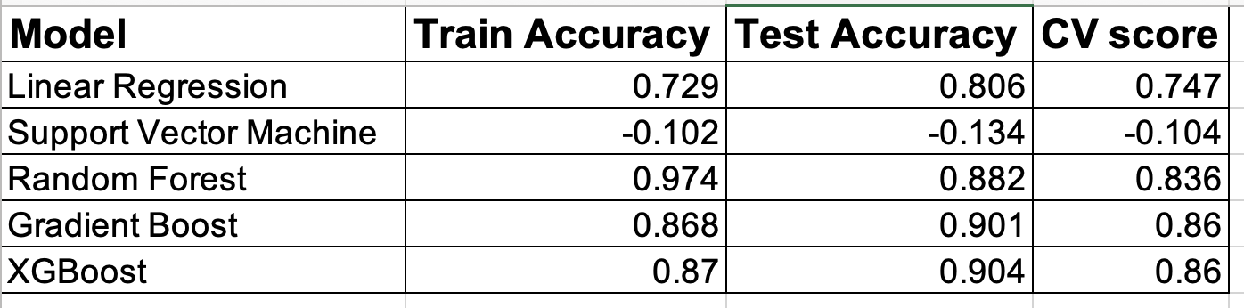
Comparison of all models:
Out of all models compared, XGBoost regressor has the highest accuracy for all the parameters which gives you consistency in predicting the expenses.

Slide 11
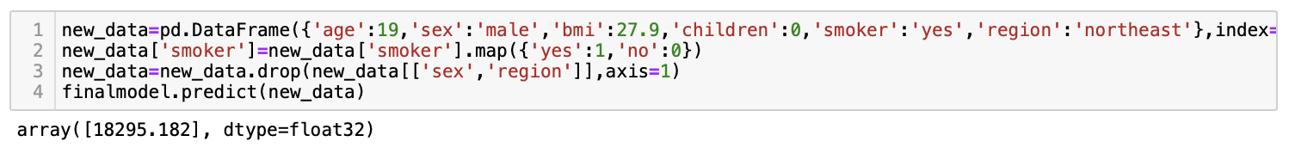
Prediction:
18295.182 shows the price prediction of the above defined parameters.

Slide 12
Conclusion:
The XGBoost model has the highest accuracy of all the models, which indicates that its predictions are more accurate than those of the other models.
In summary, the combination of Python and machine learning models for predicting medical insurance prices has shown to be a game-changer, radically improving the precision and effectiveness of premium estimates. These models, which are powered by complex algorithms, have proven to be more adept at analyzing a wide range of datasets and taking into account several factors, leading to more accurate and customized insurance pricing.

Slide 13
Thank you

